Slide 1
IPSL Merchant Payments
Wanjiku Wanyeki
Chief Client Engagement and Experience Officer

Slide 2

PesaLink – Our New Business Approach
Fintechs
Merchants
Customers
Bank 1
Pesalink
Bank 2
Billers
Businesses

Slide 3
Replacing Cash with Digital Payments
Merchant
Customer
Financial Institution
Technology provider
Cash carries the ability to be easily acquired, accepted & reconcilable. Digital Payments need to mirror the customer experience or make it even better

Slide 4
Merchant Experience
Simplicity of use
Onboarding – How does the merchant get it
Notifications
Reconciliation
Reversals / Refund
Customer Segmentation – Who has it
Cost
Technology required
Channels available – In person, Ecommerce, Integrated ERP’s

Slide 5
Customer Experience
Simplicity of use
Channels – Phone (USSD/APP), Internet Banking, In person (Branch/Back Office)
Onboarding – How does the customer get it
Notifications
Reversals / Refund
Merchant Segmentation – Who has it
Cost
Technology required

Slide 6
Financial Institution Experience
Simplicity of use
Merchant & Customer Segmentation – Who needs it
Onboarding – How does the customer and Merchant get it
Notifications
Reversals / Refund
Cost
Technology required

Slide 7
Technology Provider Experience
Simplicity of use
Onboarding – How does the merchant/ Customer get it
Technology required (Buy or build)
Cost
Partnerships (who do you play with) and how do you scale

Slide 8
Other points of consideration
Reliability – One point of truth
Security – the transaction happened as it should happen and is not subject to fraud
Notifications – who confirms to all parties?
Dealing with failures – what should happen?

Slide 9
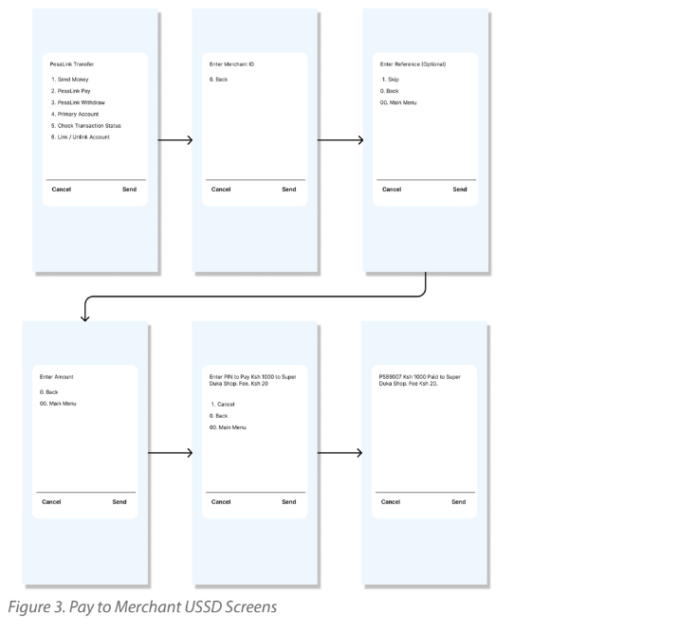

Slide 10
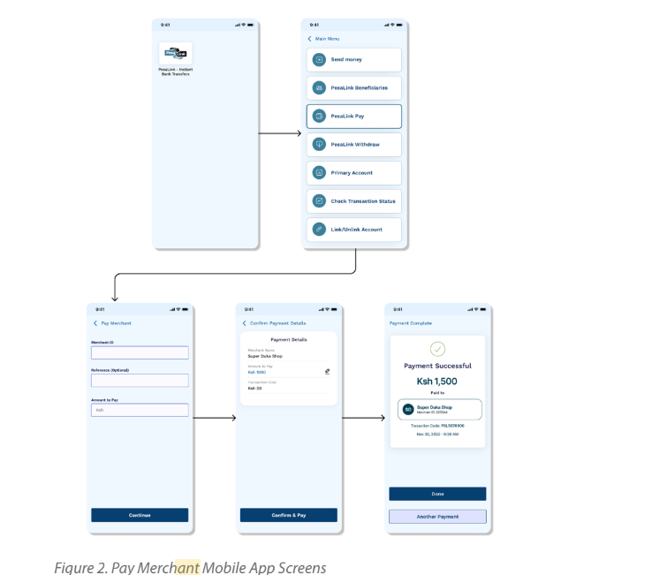

Slide 11
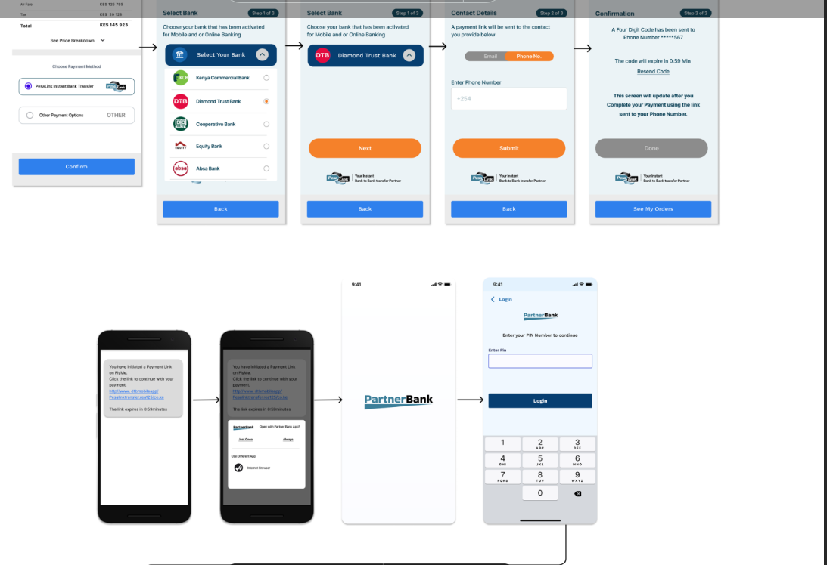

Slide 12
